Slide 1

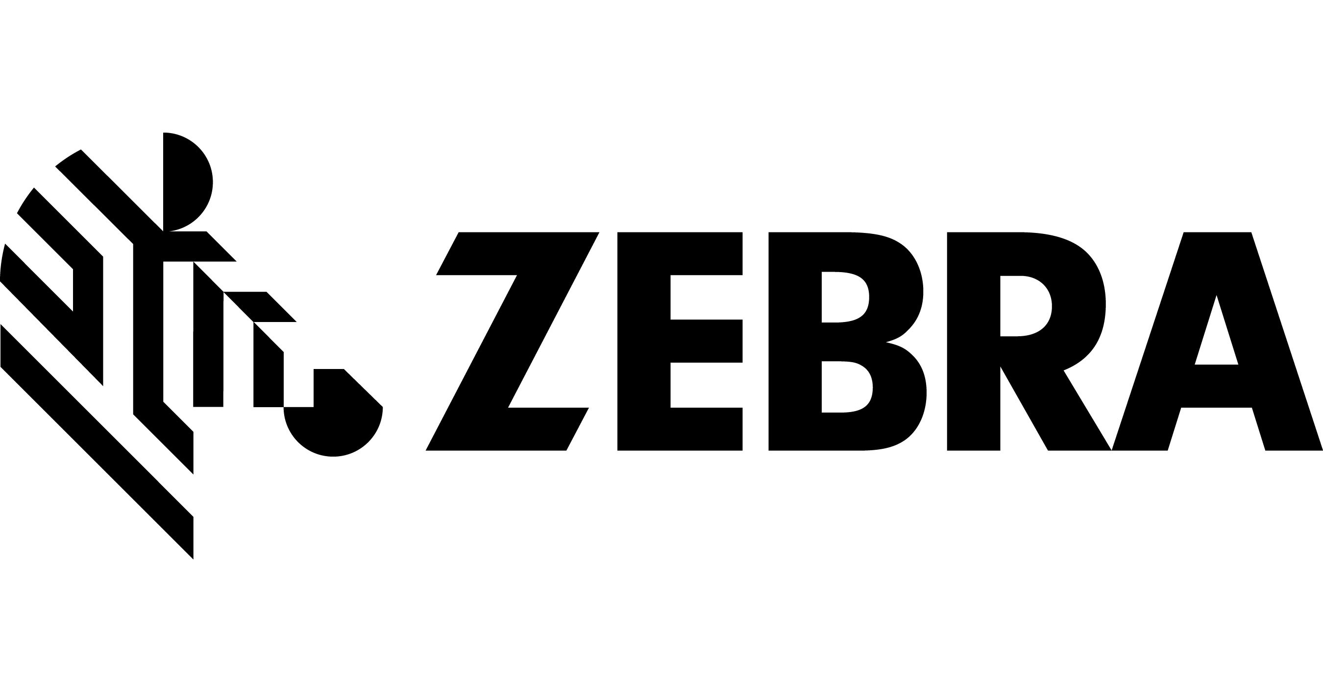
Vaccination Certification & Verification

Slide 2

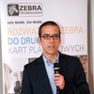





Speakers
Alex Fryer
Regional Product Manager IES, EMEA
alex.fryer@zebra.com
Ricardo Moreno
Regional Product Manager Card, EMEA
rmoreno@zebra.com
James Swinton Bland
Developer Advocate,
EMEA
james.swintonbland@zebra.com
Jelle Millenaar
Lead Identity
jelle.millenaar@iota.org
Leo Jugel
CTO
matthias.jugel@ubirch.com

Slide 3
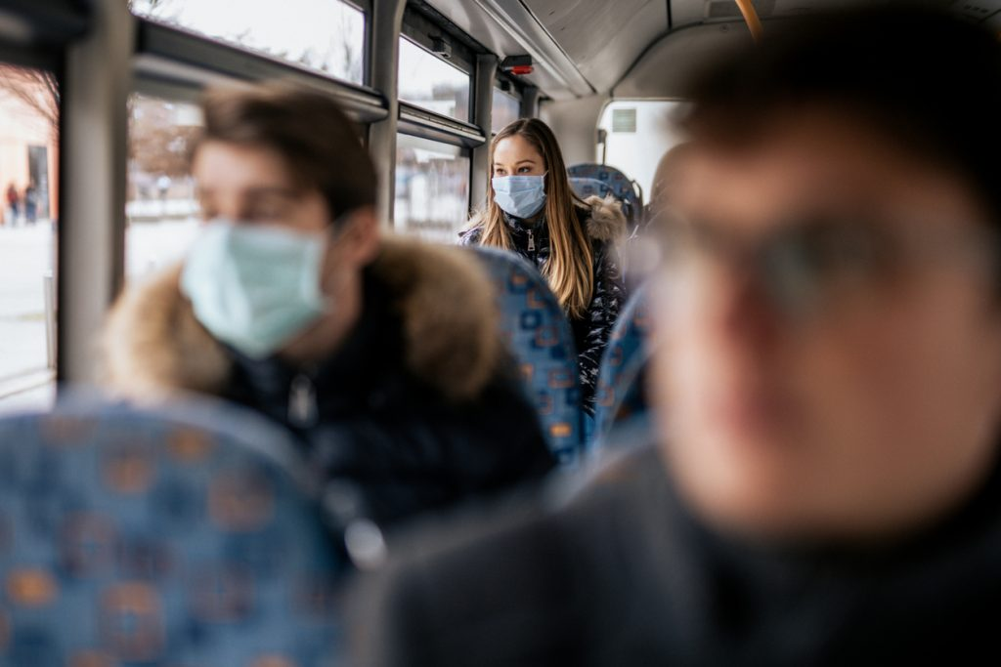
Agenda
Zebra / IOTA partnership
Introduction to the challenges of vaccination certification/verification
- Eliminating barriers to participation
- Mitigating risk of fraudulent activity
- Respecting data protection
DEMO
User flows & architecture
IOTA powered COVID test verification in action – UBIRCH
Partnership opportunity
Future developments
Q&A
Notes:
Source:
https://publichealthmatters.blog.gov.uk/2020/10/29/an-opportunity-to-address-inequalities-learning-from-the-first-months-of-the-covid-19-pandemic/

Slide 4




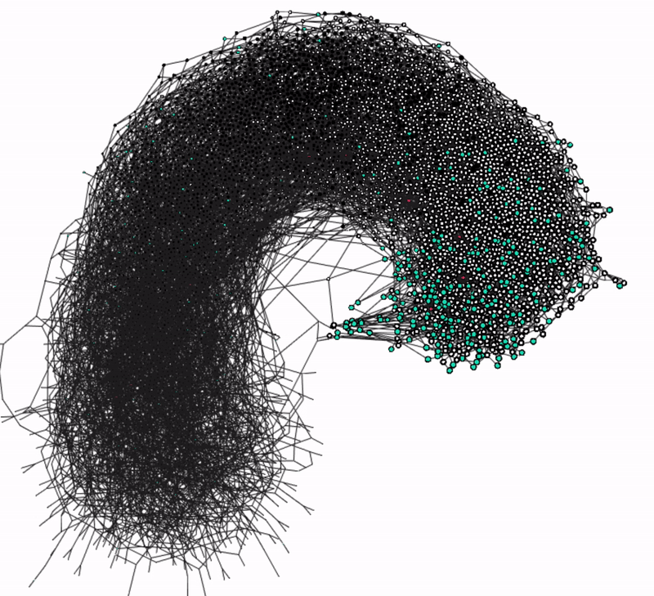
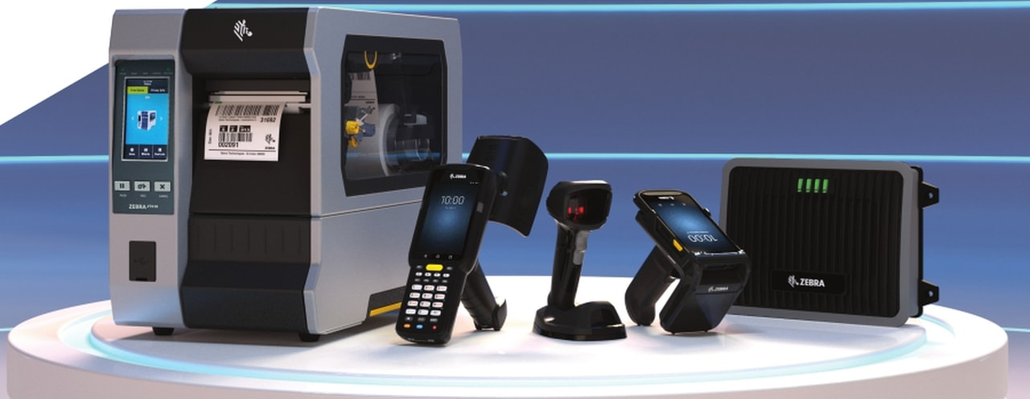
440 Academic References from 266 Academic Institutions
120+ associates in 23+ countries around the world
4,900+
10,000+
US & intl patents issued and pending
channel partners in over 100 countries
Secure data transfer
Highly Scalable
8,200+
50 years+
employees worldwide
of innovation
$447m
~$4.5B
What we deliver
The Tangle: Build and Research on Distributed Ledger Technologies
Open source software
Ecosystem / network support
R&D expenditure (2019)
global sales

Slide 5



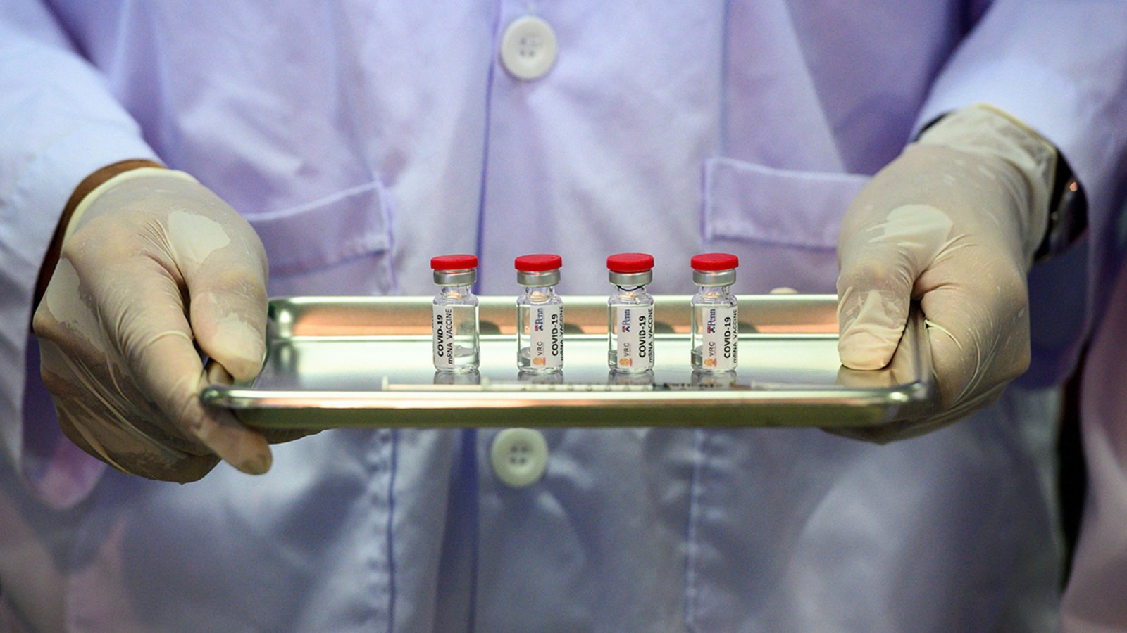
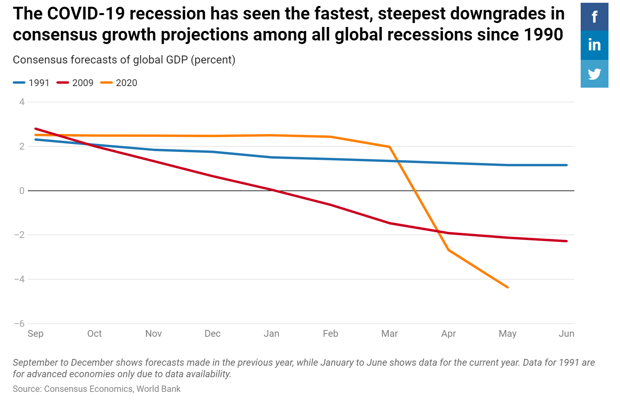
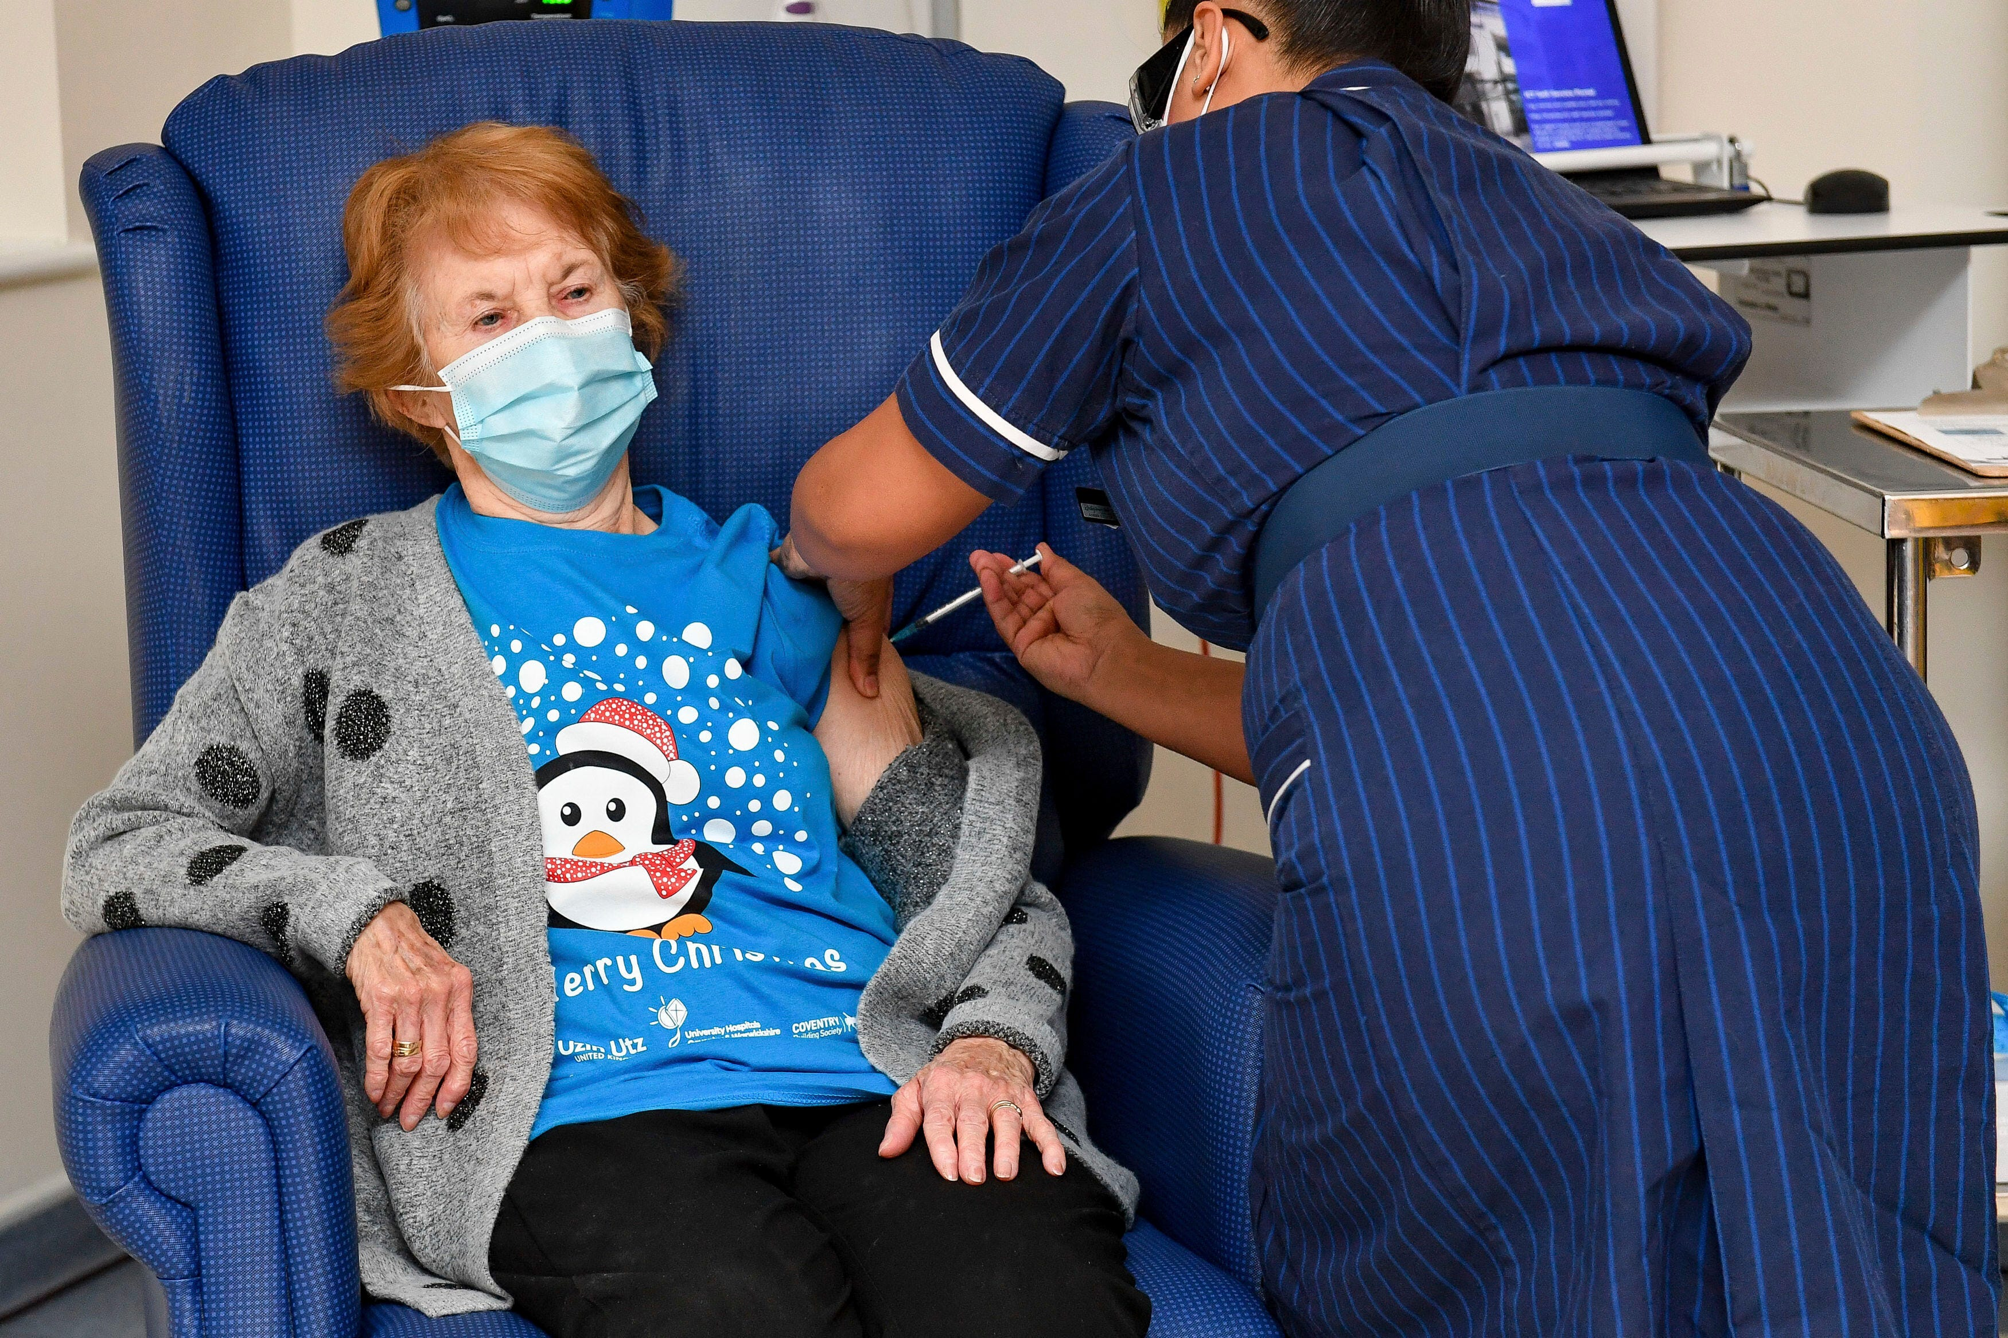
Impact of Covid-19
Accelerating the global recovery
Covid-19 has decimated several industries and the broader global economy…
…as the focus continues on vaccination distribution, the next focus will be on certification + verification of vaccination
Notes:
Source:
https://www.worldbank.org/en/news/feature/2020/06/08/the-global-economic-outlook-during-the-covid-19-pandemic-a-changed-world
https://www.cntraveler.com/story/its-not-just-airlines-airports-are-also-looking-for-government-help
https://www.pharmaceutical-technology.com/features/covid-19-vaccine-development/
https://www.cfr.org/article/politics-covid-19-vaccine

Slide 6
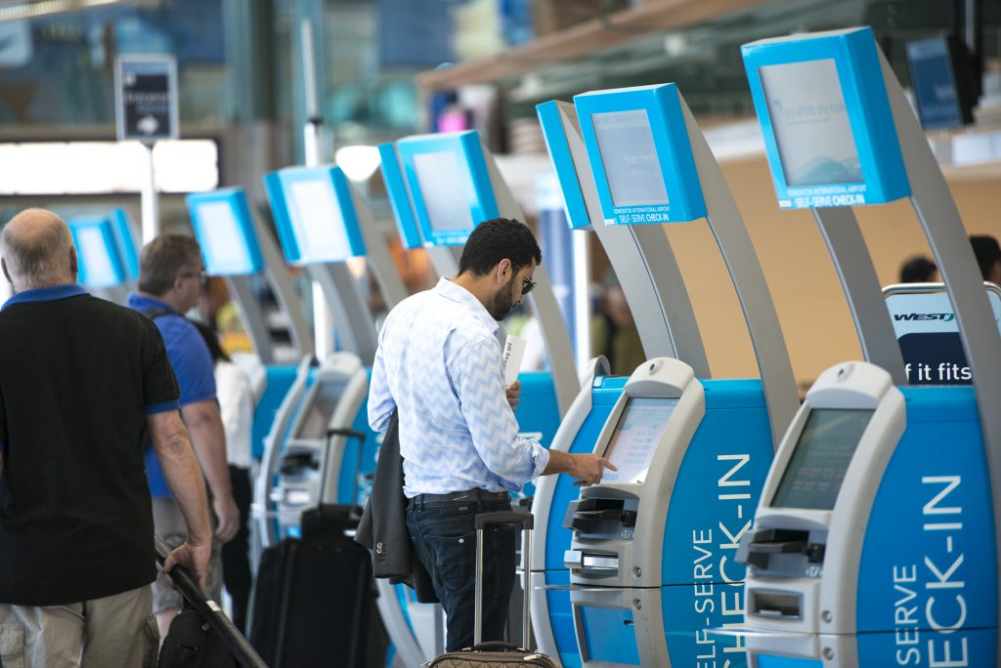
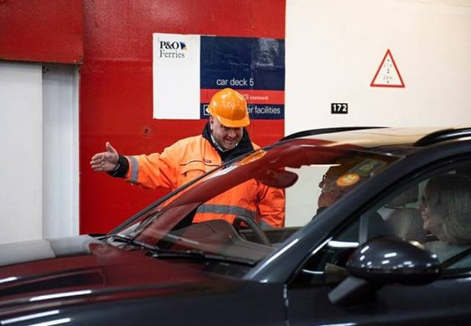




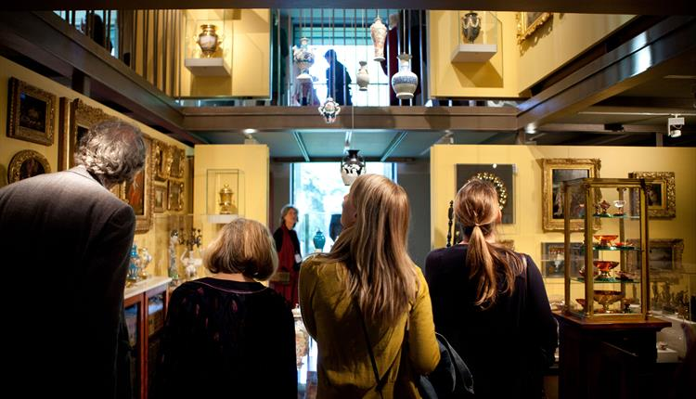
When & where will vaccination verification be required…
…and how ?
Travel
Domestic mobility
Healthcare appointment
Notes:
Source:
https://flyeia.com/flights/check-in/
https://www.railadvent.co.uk/2020/03/government-announce-new-contracts-for-great-western-railway-and-southeastern.html
https://blog.poferries.com/2019/03/08/what-to-expect-when-you-check-in-at-dover/
https://www.pinterest.co.uk/pin/459859811922409158/
https://sturminster-newton.org.uk/sturminster-cheese-festival-the-best-ever/
https://www.visitwiltshire.co.uk/things-to-do/the-holburne-museum-p25111
https://www.avogel.co.uk/health/mens-health/are-men-less-likely-to-visit-their-gp-than-women/

Slide 7

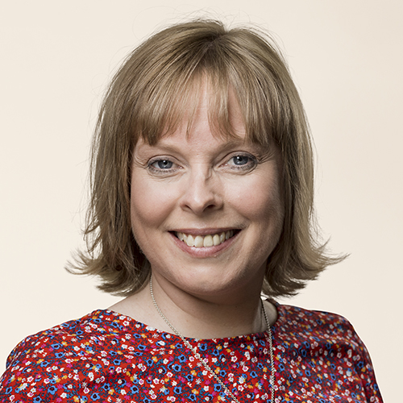
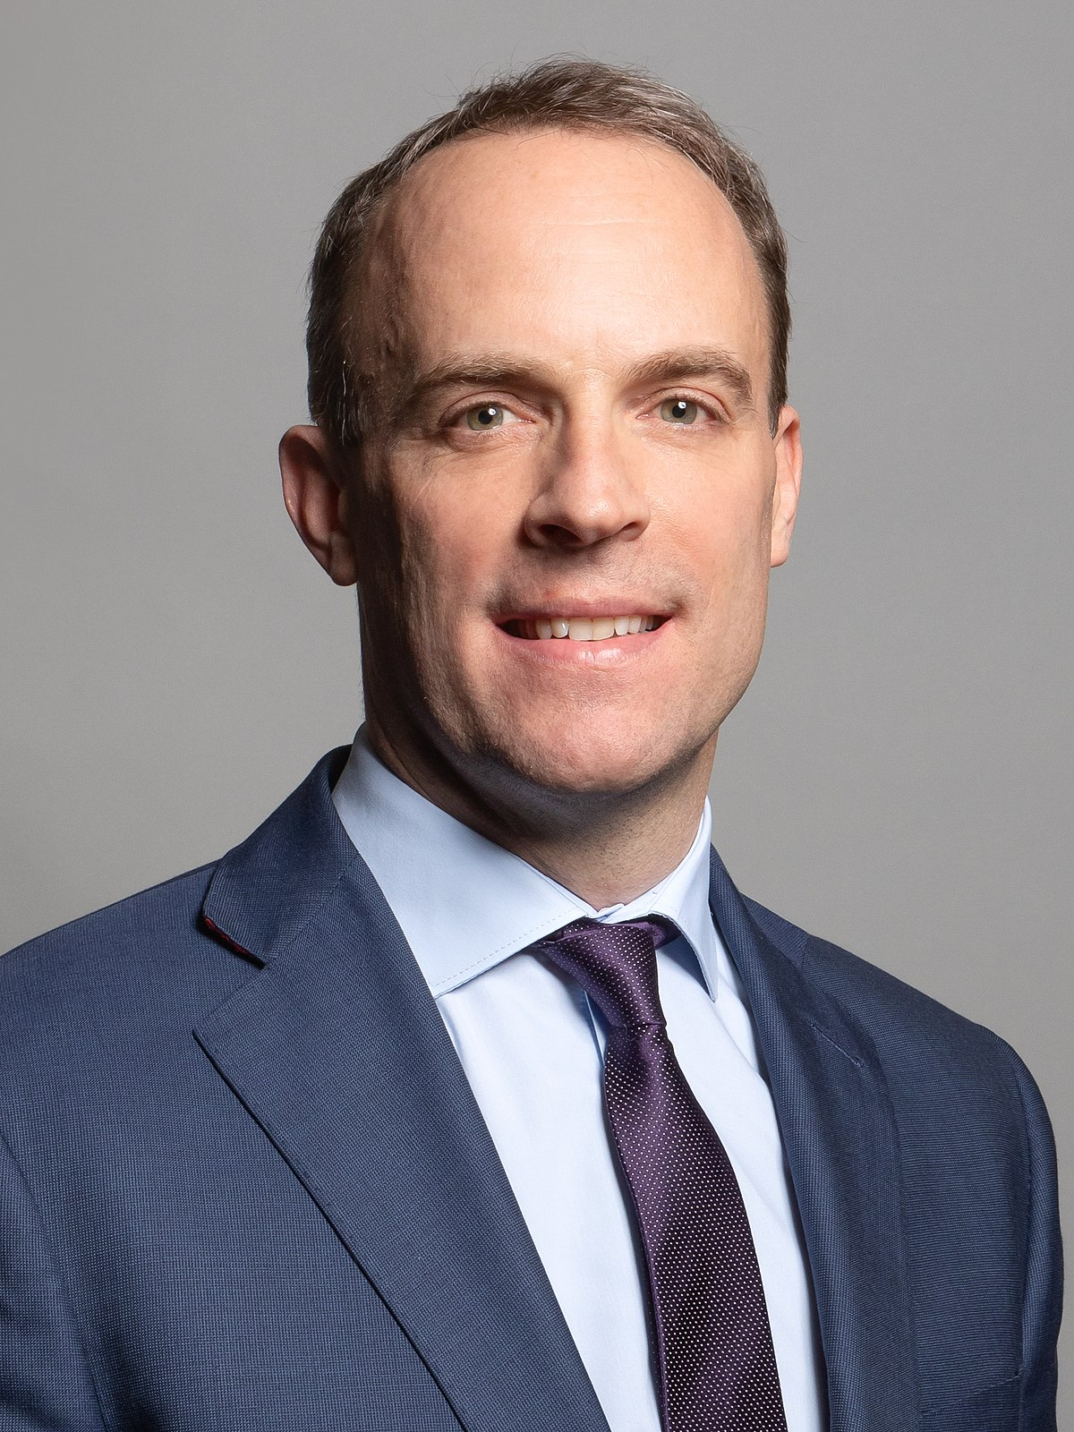
Vaccination Certification / Verification
Three key challenges
“Vaccine certification is something we are going towards inevitably. It will be a very important element to guarantee a safe return to mobility”
Challenge 1:
Eliminate barriers to participation.
Challenge 2:
Mitigate risk of fraudulent activity.
Challenge 3:
Respect data protection.
Arancha Gonzalez Laya
Spain Foreign Minister,
former Security-General of the UN
“…to ensure that the Corona passport meets the specific needs of companies and cultural life. In this way, we can design a passport that fits as well as possible to the conditions of business and cultural life.”
Joy Mogensen
Denmark Minister of Culture
“…whether it's at the international, domestic or local level, you've got to know that the document that is being presented is something you can rely on - that it is an accurate status of the individual”
Dominic Raab
UK Foreign Secretary & First Secretary of State
Notes:
Sources:
https://www.voanews.com/covid-19-pandemic/europe-split-vaccine-passports
https://www.thedanishparliament.dk/members/joy-mogensen
https://www.schengenvisainfo.com/news/denmark-working-on-digital-coronavirus-passport-in-order-to-enable-foreign-travel/#:~:text=At%20the%20same%20time%2C%20Denmark,months%20to%20come%20into%20life
https://news.sky.com/story/covid-19-domestic-vaccine-certificates-under-consideration-dominic-raab-admits-12217870

Slide 8
Challenge 1
Eliminate barriers to participation.

Slide 9
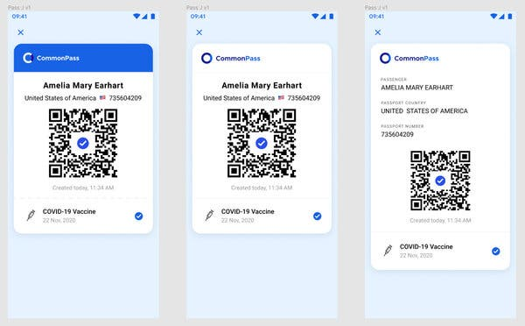
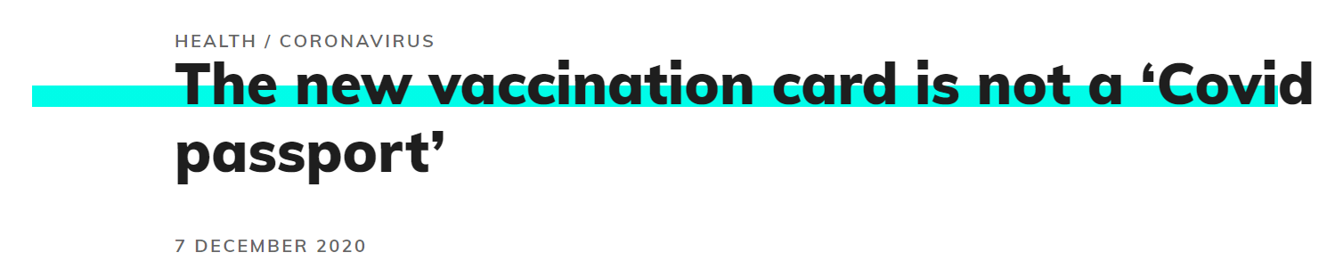
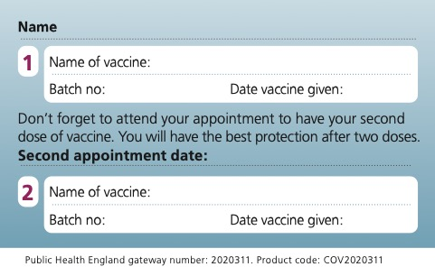
What is the de-facto form factor of a
‘Covid-19 Vaccination Passport’ ?
CommonPass, developed by the Common Projects Foundation
UK NHS Covid-19 vaccination card
Majority of proof-of-concepts are app-based.
Certain countries are giving cards or paper after vaccination, but typically not considered a ‘Covid-19 Vaccination Passport’
Notes:
Sources:
https://www.nytimes.com/live/2021/01/14/business/us-economy-coronavirus#covid-vaccine-credentials-Microsoft
https://fullfact.org/health/covid19-vaccination-card/

Slide 10

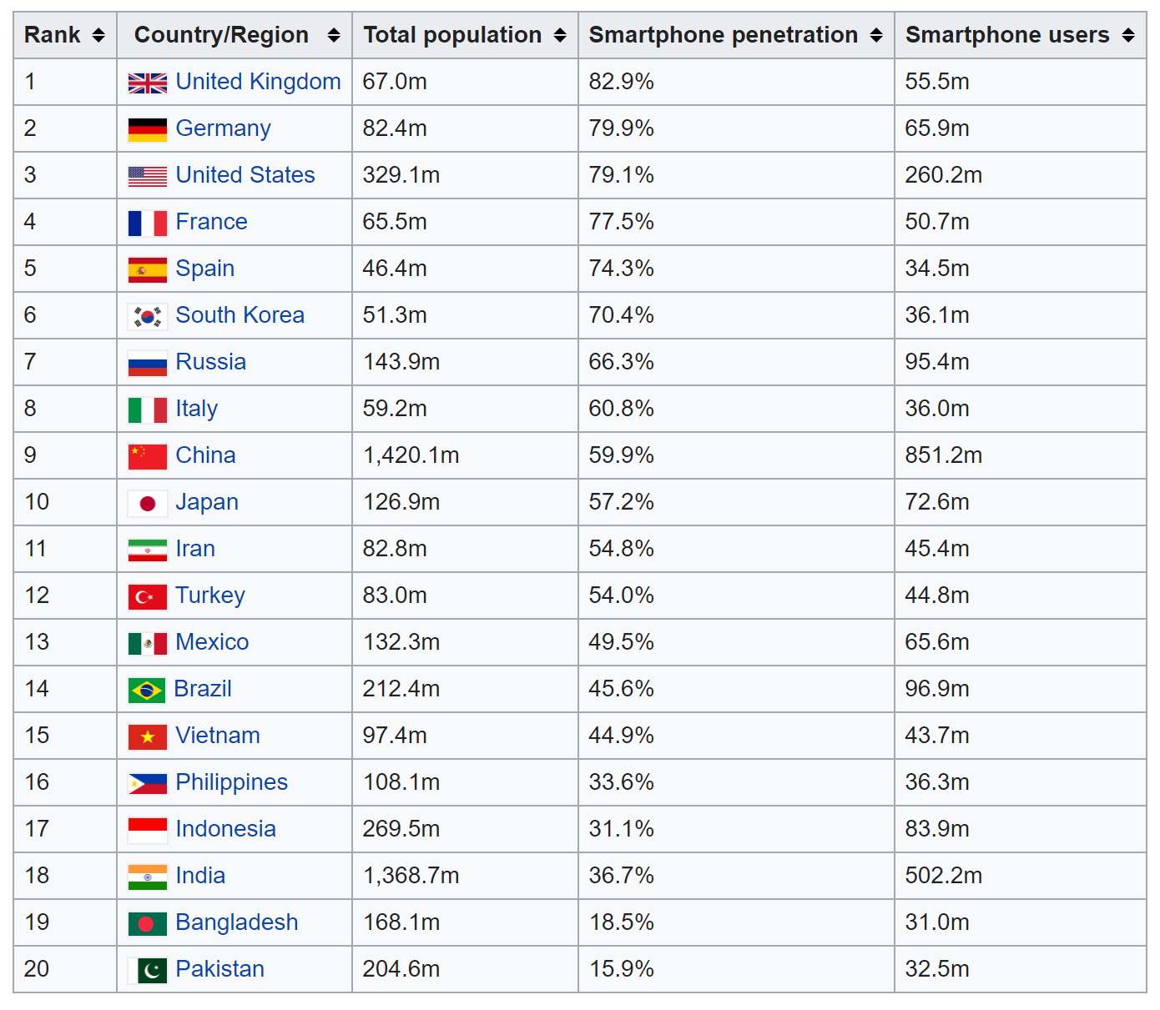
Will an app-only approach be sufficient ?
Catering for all
Downloads of England & Wales Track & Trace app as % of population*
The world is accelerating its digital transformation journey…
…however, much of the worlds’ population do not have access to a smartphone…
… and even if the person has a smartphone,
will they download the app ?
*20.5m downloads as of 9th December 2020, source in the notes
Notes:
https://www.gov.uk/government/publications/nhs-test-and-trace-england-statistics-3-december-to-9-december/weekly-statistics-for-nhs-test-and-trace-england-3-december-to-9-december#nhs-covid-19-app-in-england-and-wales

Slide 11

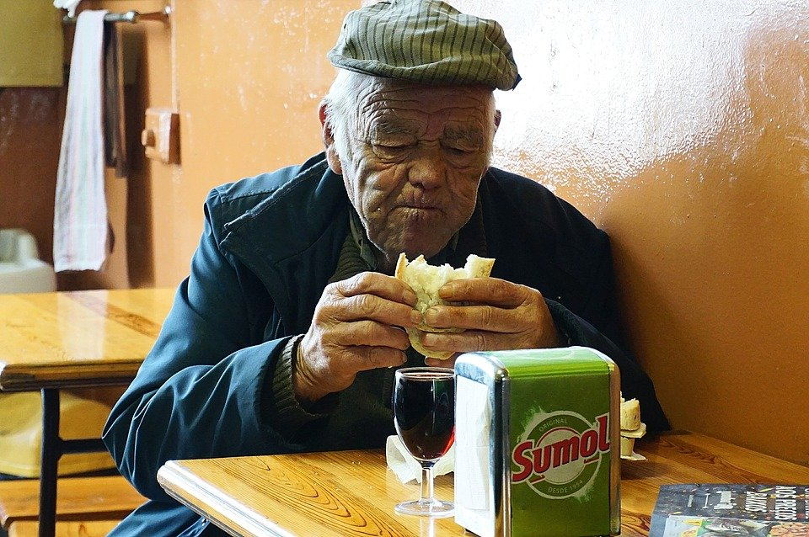
Challenge
How do we build a vaccine verification system in which participation is not restricted ?

Slide 12
Challenge 2
Mitigate risk of fraudulent activity.

Slide 13

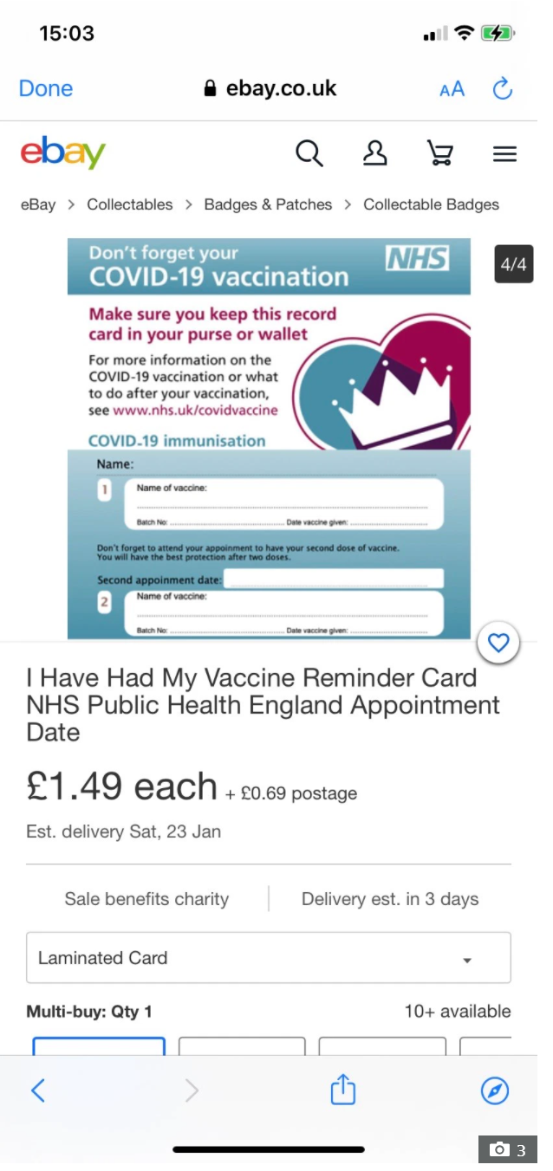
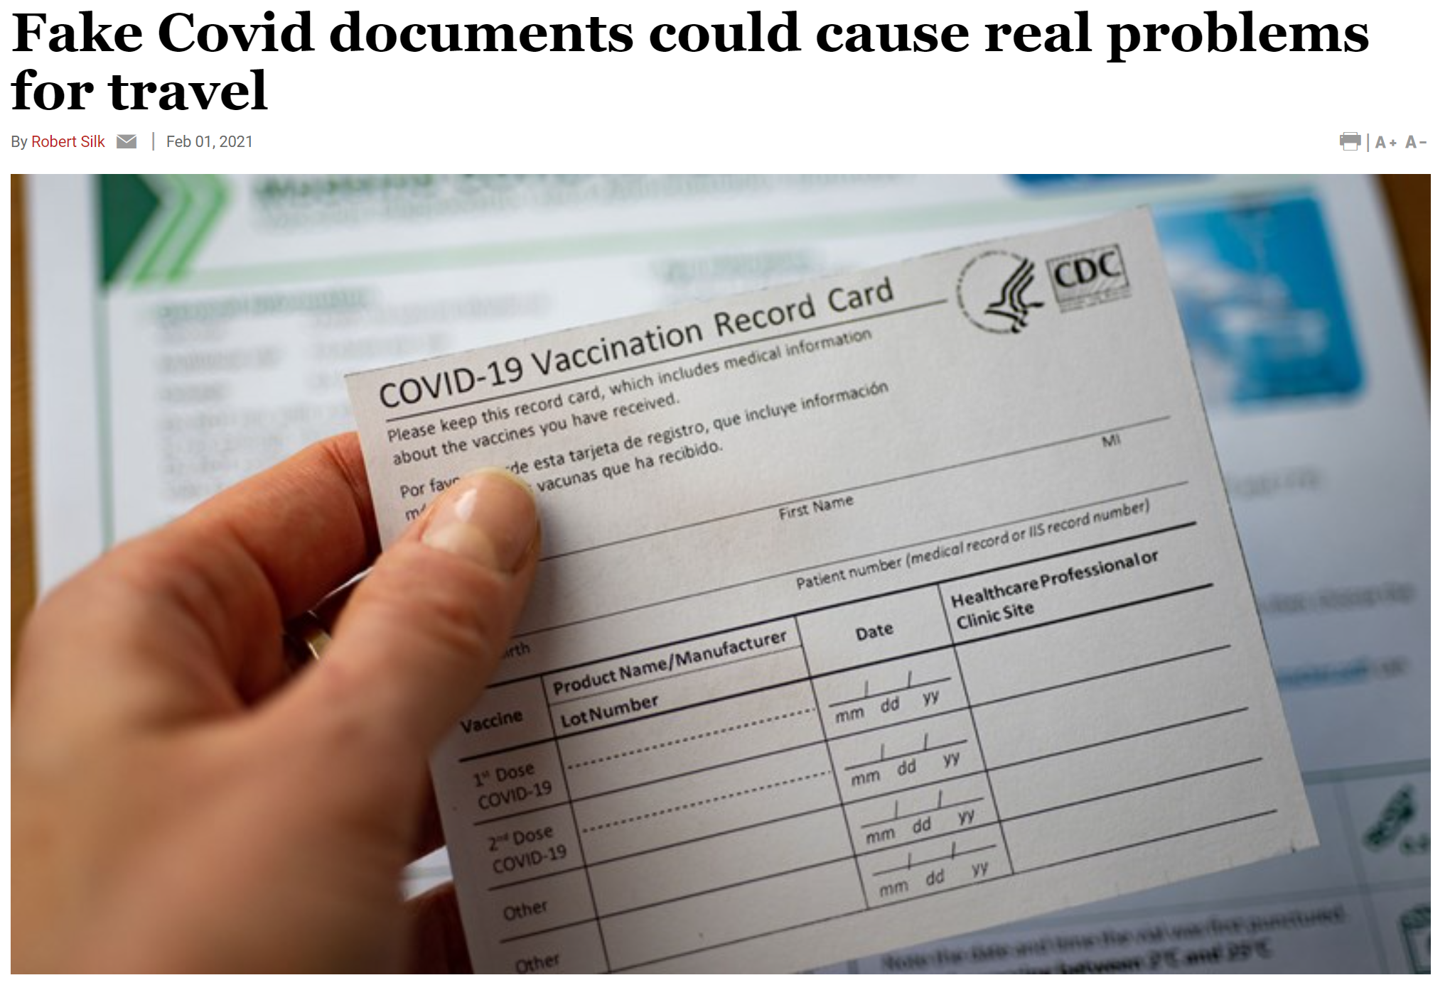
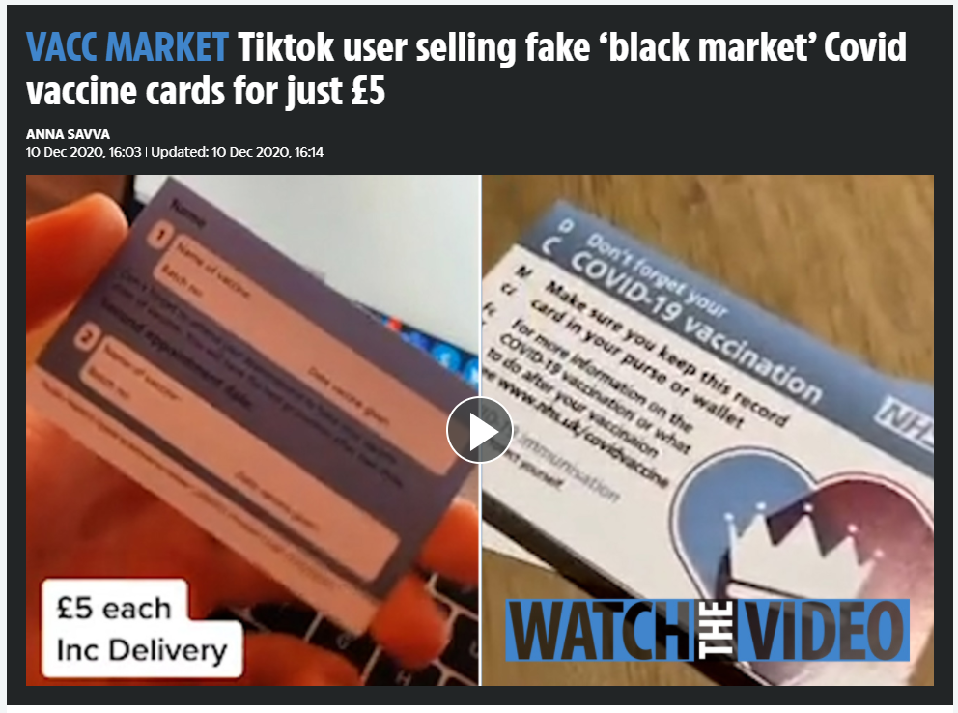
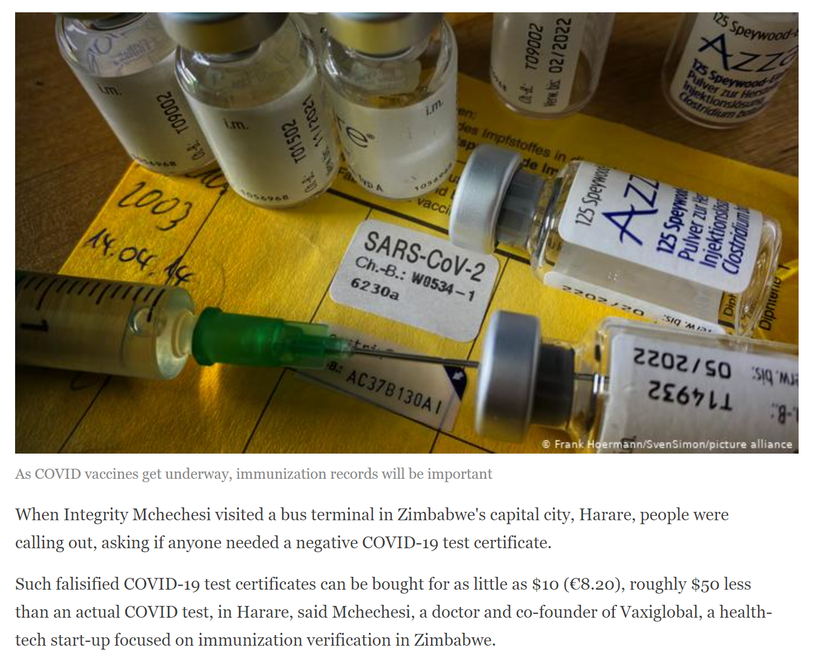
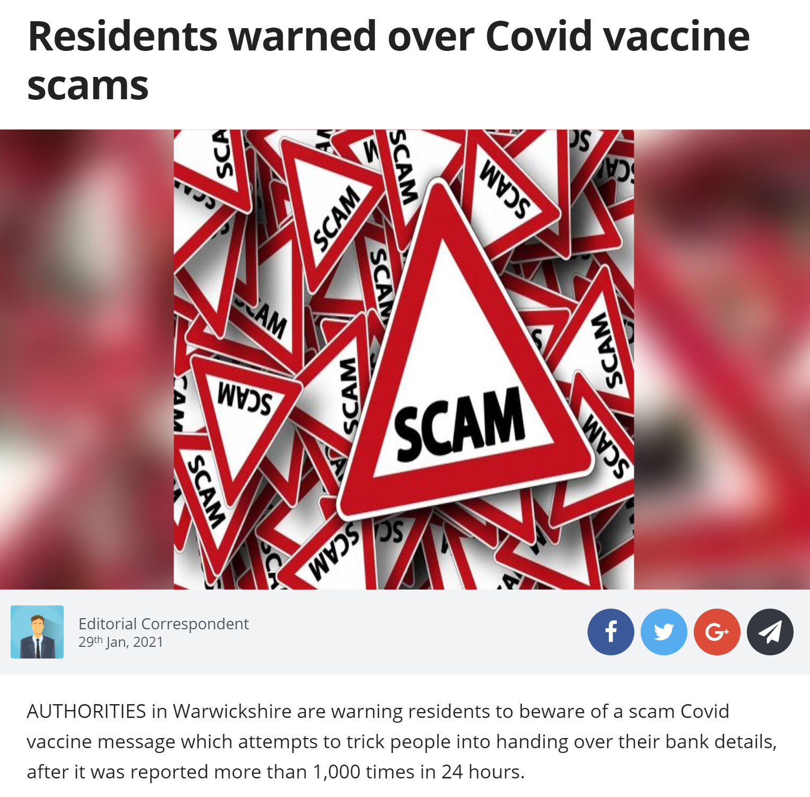
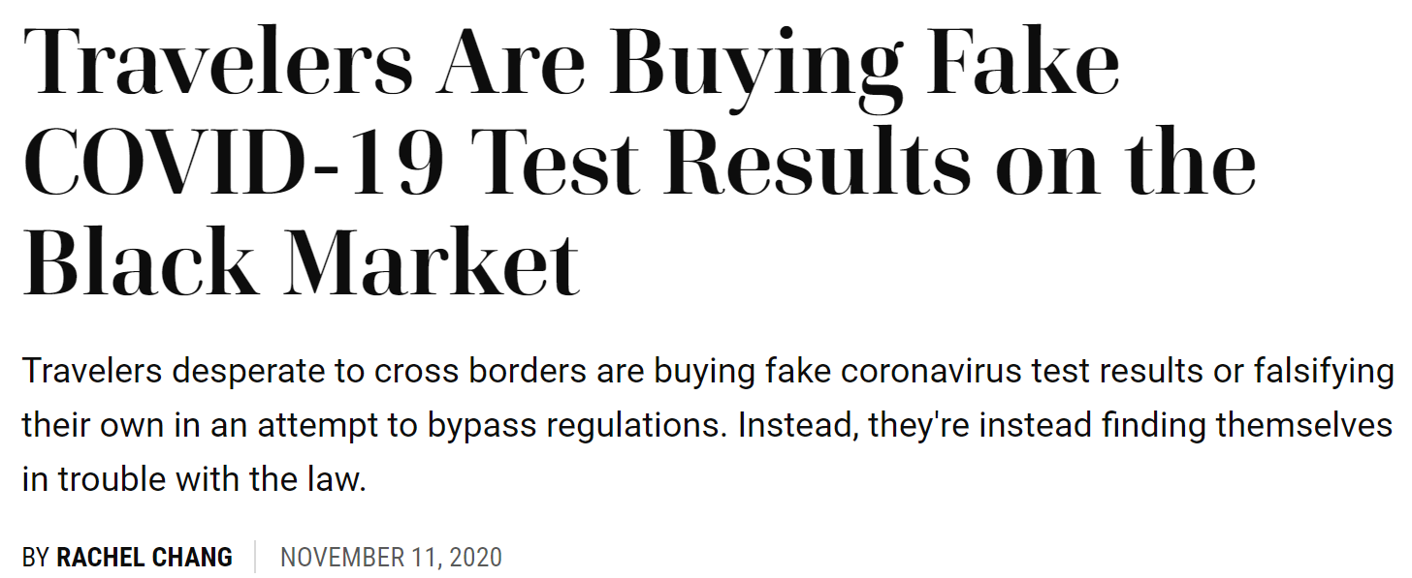
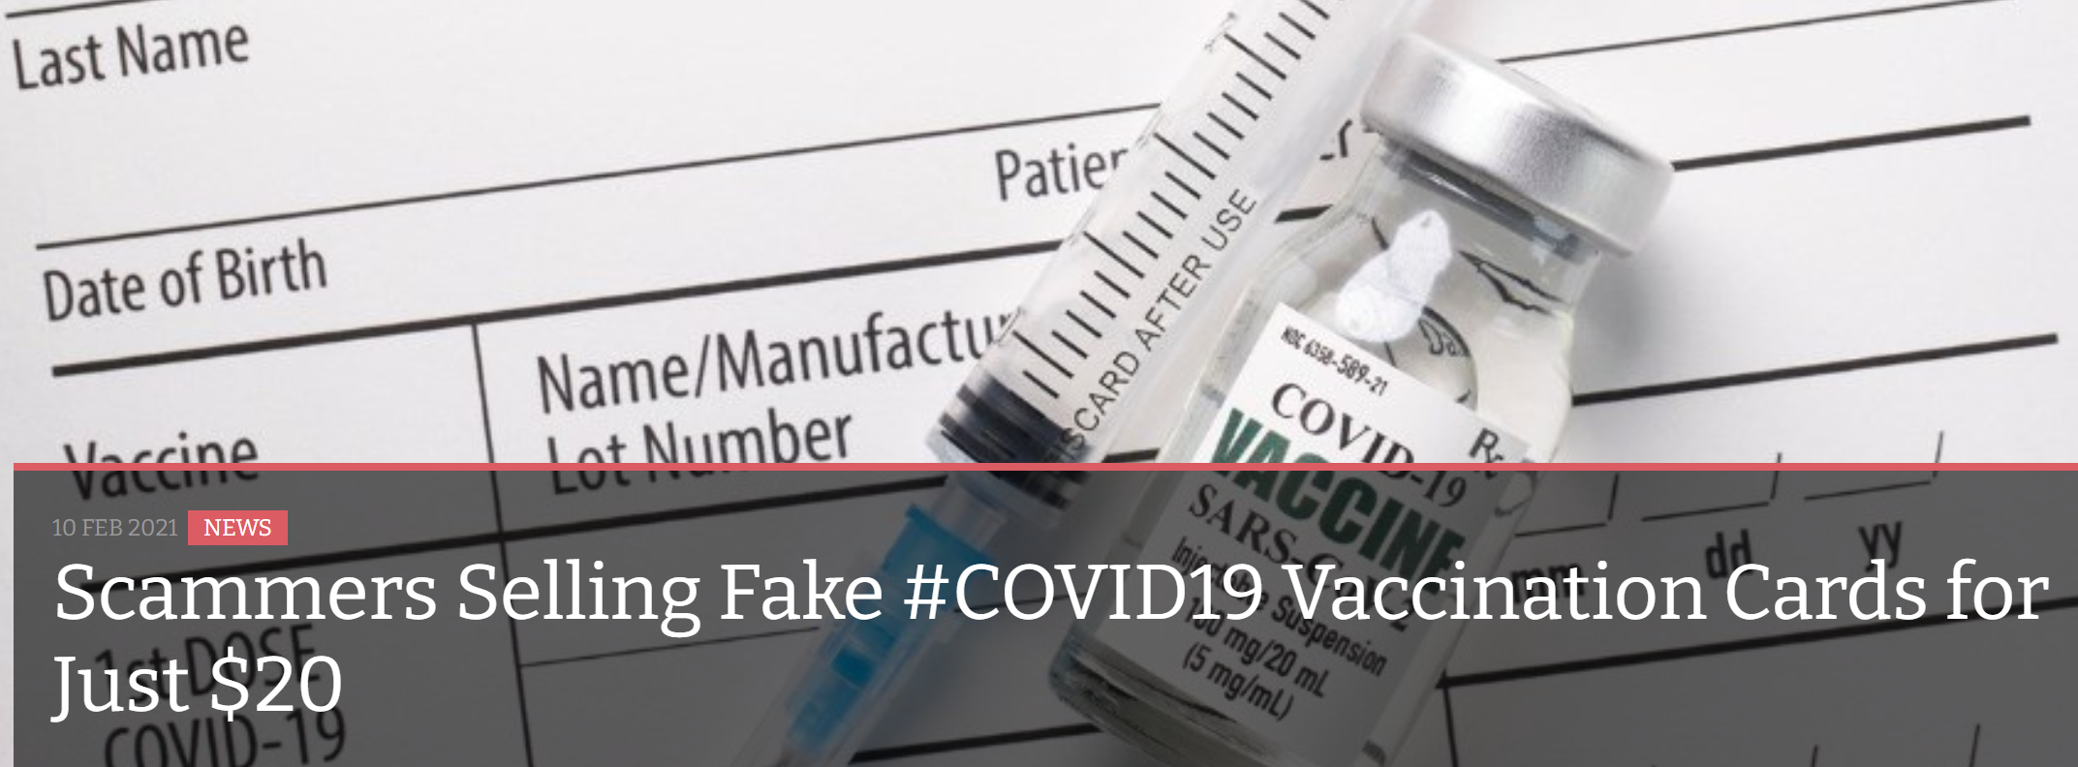
Fraud risk of physical verification
“You download the email, change it and print it”
A physical identifier is necessary, but there are risks
Notes:
Sources:
https://www.travelweekly.com/Travel-News/Airline-News/Fake-Covid-documents-could-cause-real-problems-for-travel
https://leamingtonobserver.co.uk/news/residents-warned-over-covid-vaccine-scams-27352/
https://www.infosecurity-magazine.com/news/scammers-sell-fake-covid19/
https://www.thesun.co.uk/news/13877672/covid-fraudsters-flogging-fake-coronavirus-vaccination-cards/
https://www.thesun.co.uk/news/13439089/tiktok-vaccine-covid-card-passport-fakes/
https://www.travelandleisure.com/travel-news/travelers-using-counterfeit-covid-test-results
https://www.dw.com/en/covid-19-who-races-to-develop-vaccination-card/a-56352930

Slide 14

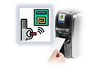
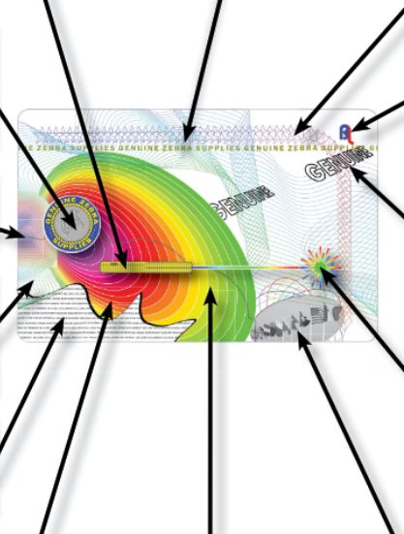
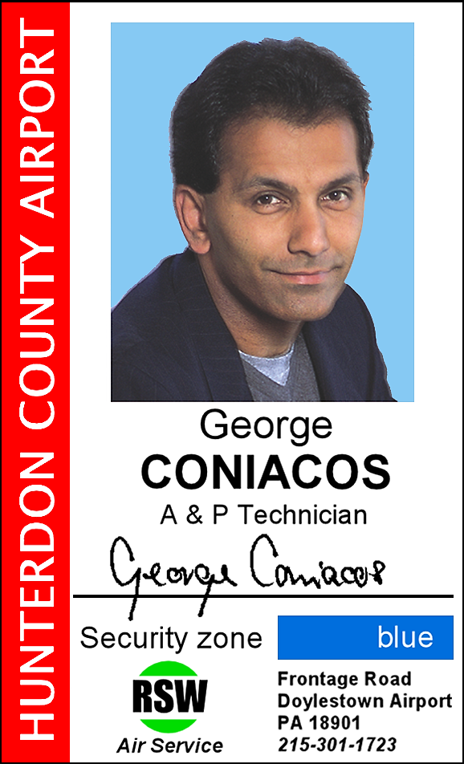
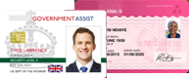
Securing the physical identifier…
…as well as the data
Hidden Imagery/Laser Retrievable Image
Optical Variable Ink Printing
Morphing
2-D/3-D Holography
Two Channel Image/Flip Image
Micro Text
Two Channel Image/Flip Image
Fine Line
Printing
Robust identity system built on industry standards
Simple and accessible to create a new digital identity, whether you are an individual or organization
Decentralized, democratic verification system
Pseudo Color
Nano-Text
Circular Kinetic
Grayscale Image Effect
Linear Kinetic Effect

Slide 15

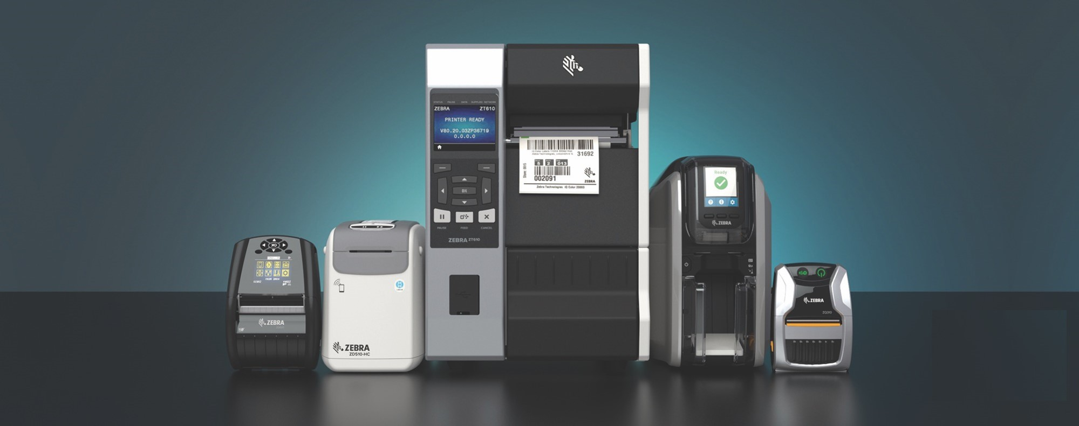
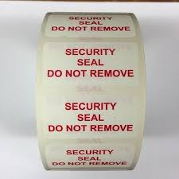
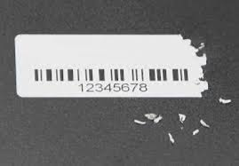
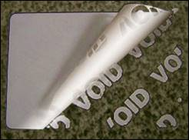

Securing the physical identifier…
…as well as the data
Robust identity system built on industry standards
Simple and accessible to create a new digital identity, whether you are an individual or organization
Decentralized, democratic verification system
Economical Solution
Highly Secured personalisation
Deployed Quickly

Slide 16
Challenge 3
Respect data protection.

Slide 17


IOTA Identity
Secure digital identities for individuals, organizations and devices

Slide 18



The internet has a trust problem
A monopolized internet
War on privacy
Rising IoT
(in)security
Big tech does online identification
Pay with our data
Privacy-centric regulation like GDPR is a complicated
Difficult for organizations
to comply
IoT devices insecure
Device data untrustworthy
Notes:
You controlled your data (reduce exploitation/ data scraping)
KYC and online sign-up processes don’t exist anymore (reduce costs & time)
As a company you don’t need to worry about handling data in a GDPR compliant way (reduce security and compliance costs)
Automated decisions are made transparent and the devices behind them can be accountable (decrease cost through secure systems automation)
Growing disconnect between the digital and physical world, making it difficult to build trust online
Physical, printed solutions:
Difficult to distribute, store and provide authenticity
Cannot be signed
Digital PDFs can easily be tampered with, shared without the owner’s permission, and are difficult to view on smartphones
Hard to identify who you’re talking to online
Internet was not built to store personal information
Open internet → Deplatforming
Lack of online trust and privacy
Identities centralized by applications, leaving personal information vulnerable to being hacked
Little transparency with how data is being generated, stored and used
Individuals giving away their data for free and not receiving financial benefits
Current solutions have major flaws
Reconciliation of data between databases

Slide 19

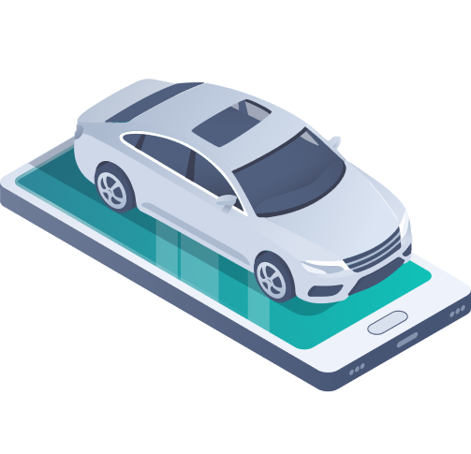
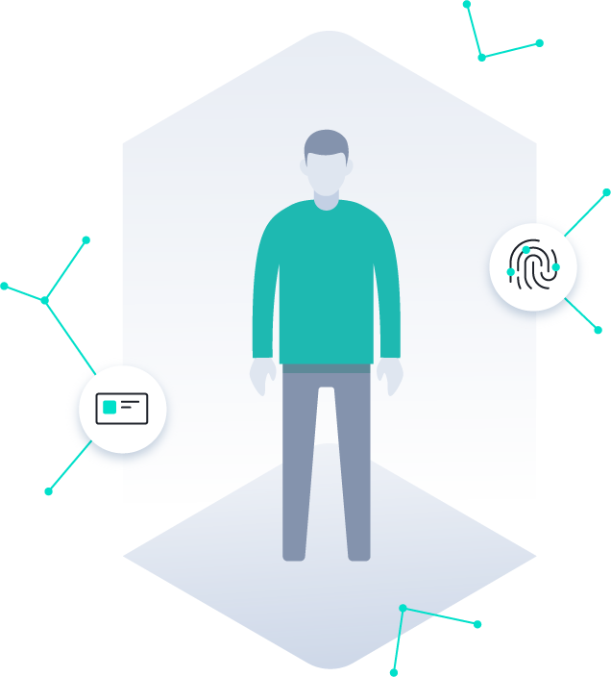
Decentralized identities enable data sharing, building trust online
Identity for
People
Identity for Organizations
Identity for
Devices
Prove your own identity online
Keep ownership and control over your personal data Share verifiable data
Onboarding customers with digital identities
Improve digital business processes and auditing
Access to and control of devices
Data authentication
Source authentication
Notes:
Identity for people: Self Sovereign Identity allows people to “Bring your own Identity” for verification. More privacy and more trust in data for a borderless digital identity.
Identity for organizations: Customer enrollment eased without the need for KYC/AML operations. Easily comply with GDPR and save costs. New business opportunities.
Identity for devices: Devices are able to prove many attributes including their capabilities, specifications and authenticity. Other actors will only interact with devices that can prove their ability to fulfill the required task.

Slide 20

Digital societies need decentralized digital identities
Built on a common platform, IOTA Identity unlocks opportunities
and data across individuals, organizations and devices
With multiple different types of actors requiring a digital identity, there is an opportunity to use the same underlying protocol for all of them, making interactions seamless - and opening up new possibilities.
This identity framework must be open, decentralized, scalable and free - for everyone and everything.
Notes:
Identity for people: Self Sovereign Identity allows people to “Bring your own Identity” for verification. More privacy and more trust in data for a borderless digital identity.
Identity for organizations: Customer enrollment eased without the need for KYC/AML operations. Easily comply with GDPR and save costs. New business opportunities.
Identity for devices: Devices are able to prove many attributes including their capabilities, specifications and authenticity. Other actors will only interact with devices that can prove their ability to fulfill the required task.

Slide 21



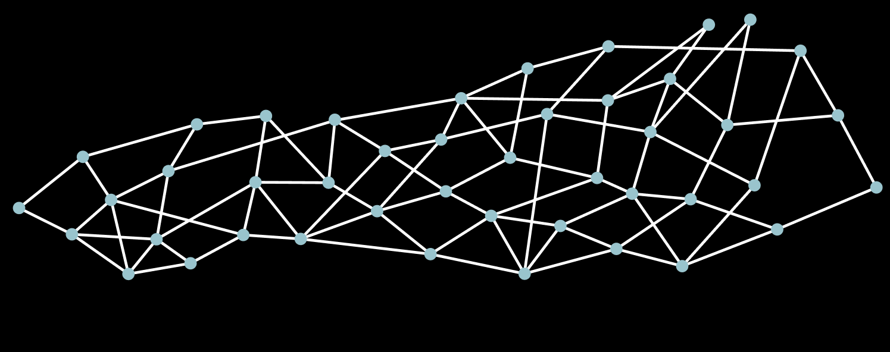
Enabling peer-to-peer trust
We combine W3C standards for Decentralized Identifiers and Verifiable Credentials (VC) with the IOTA Tangle
Issuer
Holder
Verifier
A trustworthy party on a specific subject. They verify and digitally sign the credential.
ISSUES
VC
They acquire, hold and present VC using private keys, which are under their control.
PRESENTS
VC
Able to verify credentials shared by the holder.
IOTA Tangle
The Tangle is a scalable, feeless and secure DLT. It serves as a decentralized public key infrastructure.
Notes:
Verifiable Credentials: Verifiable Credentials are statements about real-world attributes from the “Holder”. They are controlled by the Holder and can be shared, verified and trusted.
Creation of trust through identification in an online setting.
This is crucial for both the internet and DLT as identifying who you interact with online can prevent many cases of fraud, disinformation, and distrust.
People will be able to identify and trust other people and organizations online, reducing fraud, while devices will be able to trust other devices, drastically increasing the security of systems.
In a future where everyday objects are connected, trusted human-to-machine interaction will be enabled through a trustworthy, neutral and secure Unified Identity Protocol.
IOTA ledger enables progress of tasks to be immutably logged
Robust open source code base, developed with XYZ partners
Supported by products
→ With the combination of the IOTA protocol and the Unified Identity framework, we can automate the entire interaction between all parties, without requiring predefined trust.
01 HOLDER: This is usually a subject of the digital identity. They have generated their DiD and cryptographic keypairs. Their personal data and private keys are under their own control.
02 ISSUER: An issuer is a trustworthy party on a specific topic. They have their own digital identity. The issuer provides a user with verifiable credietnials, which they sign using asymmetric encryption.
03: VERIFIER: A HOLDER shares their verifiable credentials with a VERIFIER to prove a statement about themselves. The VERIFIER is able to verify the credentials by performing the following verifications:
Data integrity: are the credentials signed by the expected parties?
Issuer trust: is the credential unaltered?
Signature verification: Do I trust this ISSUER to provide these credentials?
Validation: is the credential still valid?

Slide 22
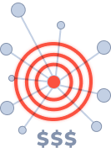
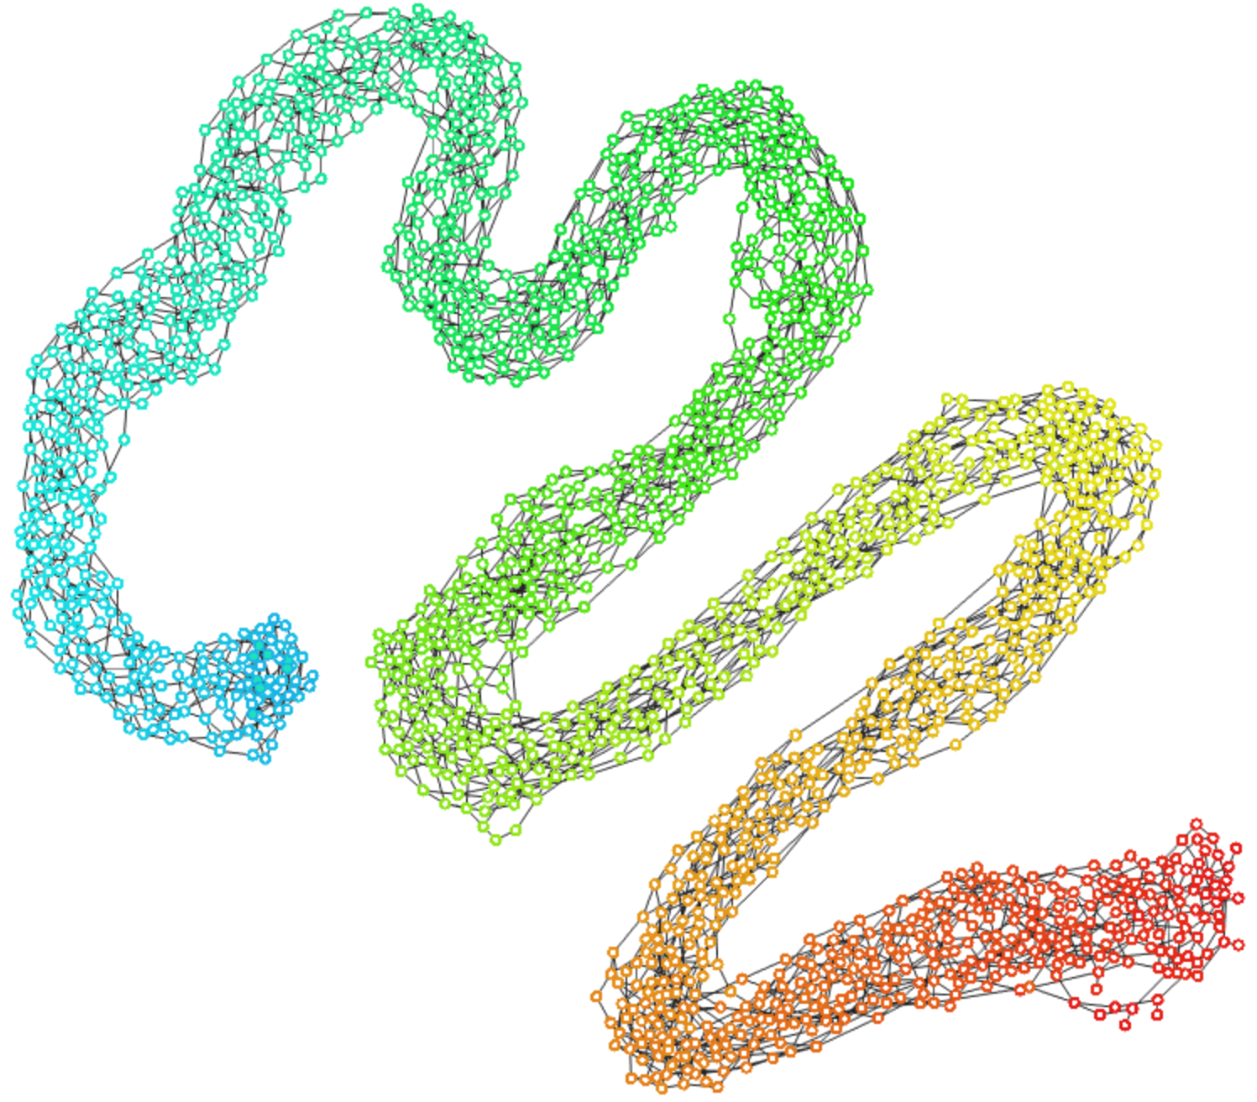


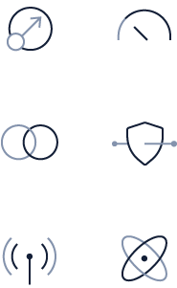
How is the Tangle different to other architectures?
Centralized
Blockchain
Tangle
Unsuitable for digital identities - a single point of failure and a target for attacks.
Requires close government cooperation to develop an international solution.
Governments or corporations control user data in central databases.
Immutable Data
Highly Scalable
Decentralization
Feeless Transactions
All activity requires holding cryptocurrency token and incurs transaction fees.
Fees can change and spiral due to network demand.
Mining is a waste of resources.
Inherently unscalable. Blocks are limited in size and frequency.
Low Energy Requirements

Slide 23


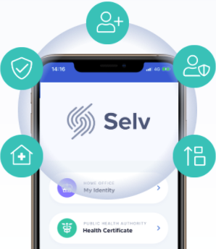

Selv: Health Passport
Identity Wallet with COVID-19 Test results demo
A new digital identity can be freely created by any individual or organisation.
IOTA Identity as foundational framework interoperability
Try the Selv: selv.iota.org
✔️ Easy integration in any existing application
✔️ Out-of-the-box Security, Identity management and Verification
✔️ Provides interoperability between vendors

Slide 24
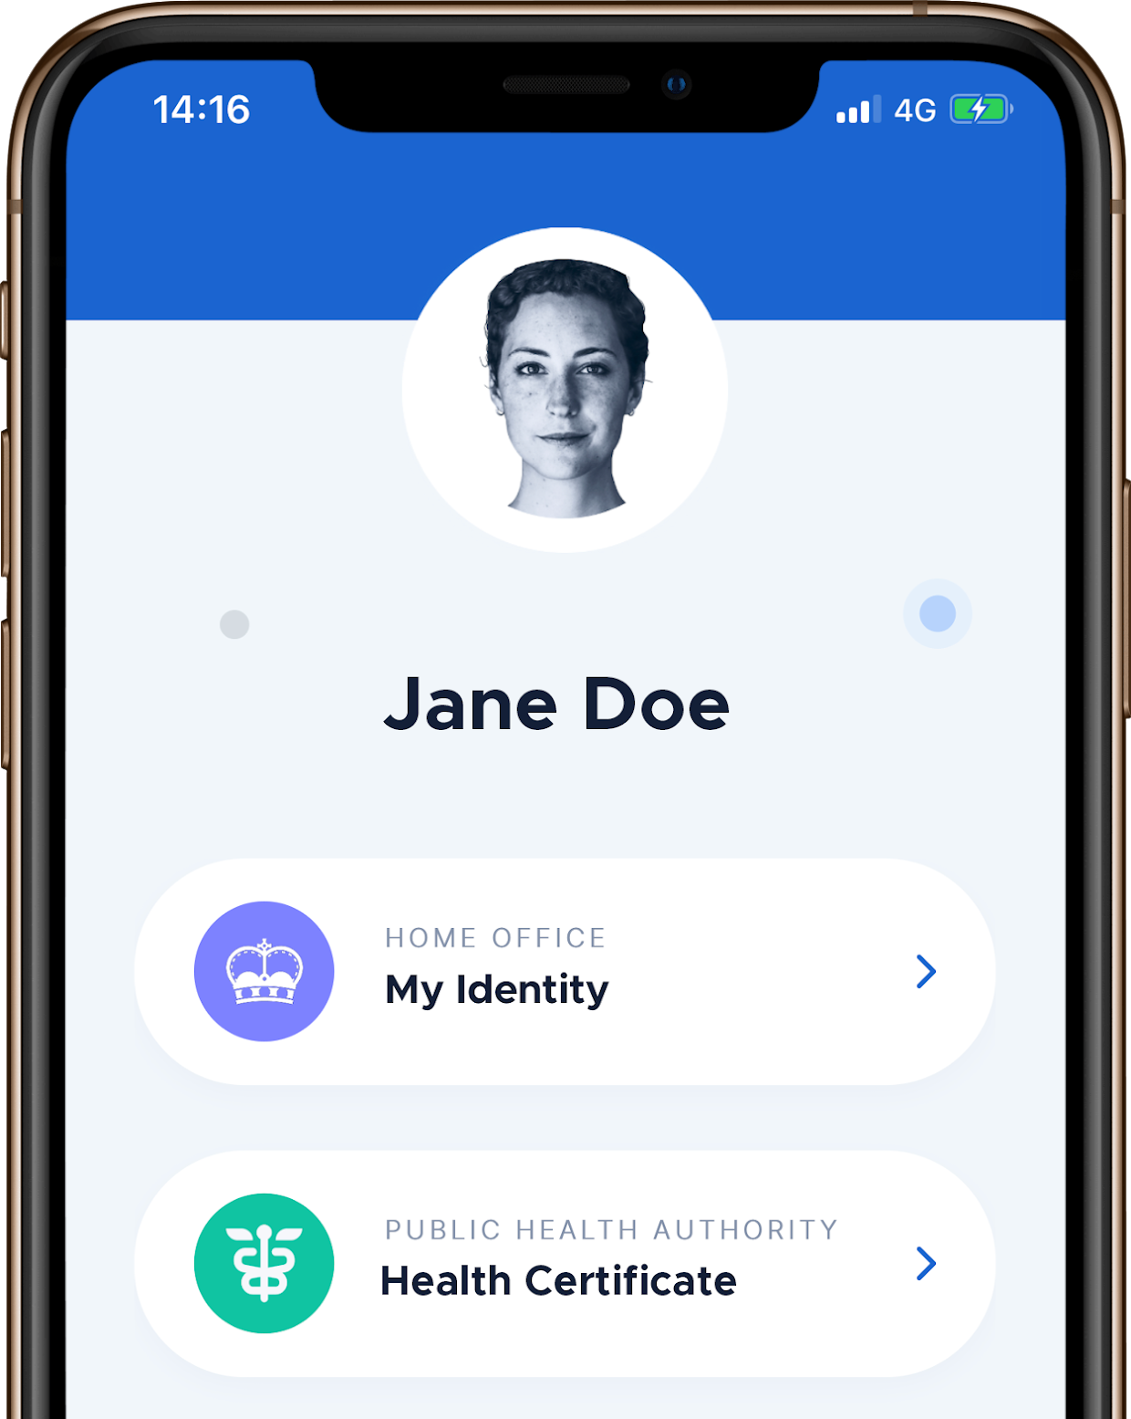
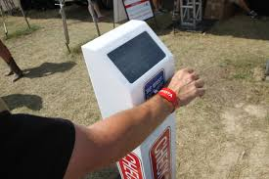


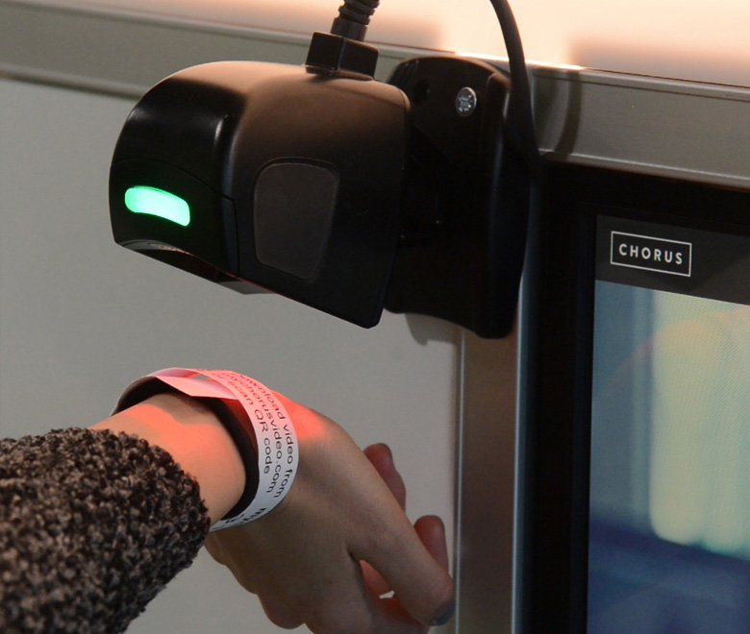

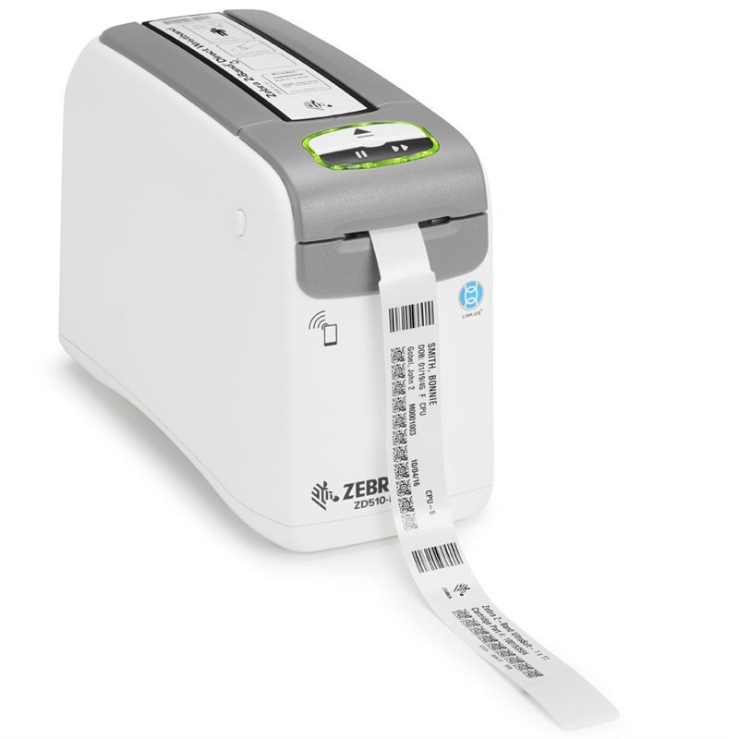
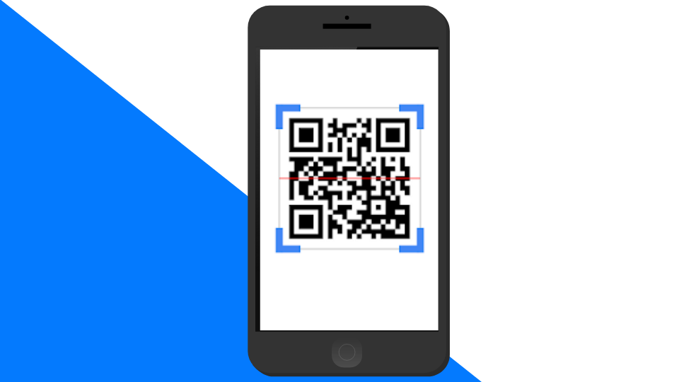
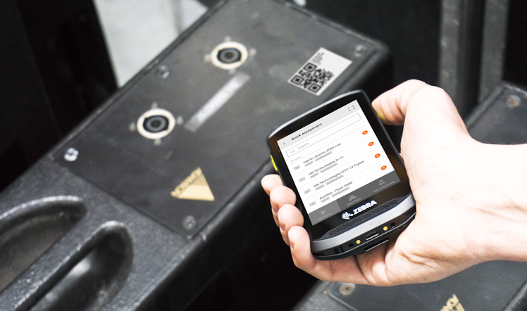

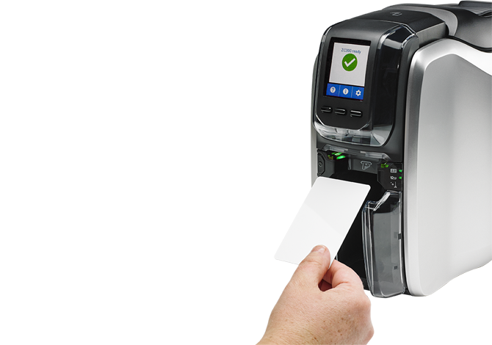
Simple to use removing restrictions on participation
Regardless of the storage mechanism of the user’s vaccine status (smartphone, QR code/barcode, wristband, card etc), the verification method is consistent. Ensures simplicity for user and verifier.

Slide 25
DEMO

Slide 26


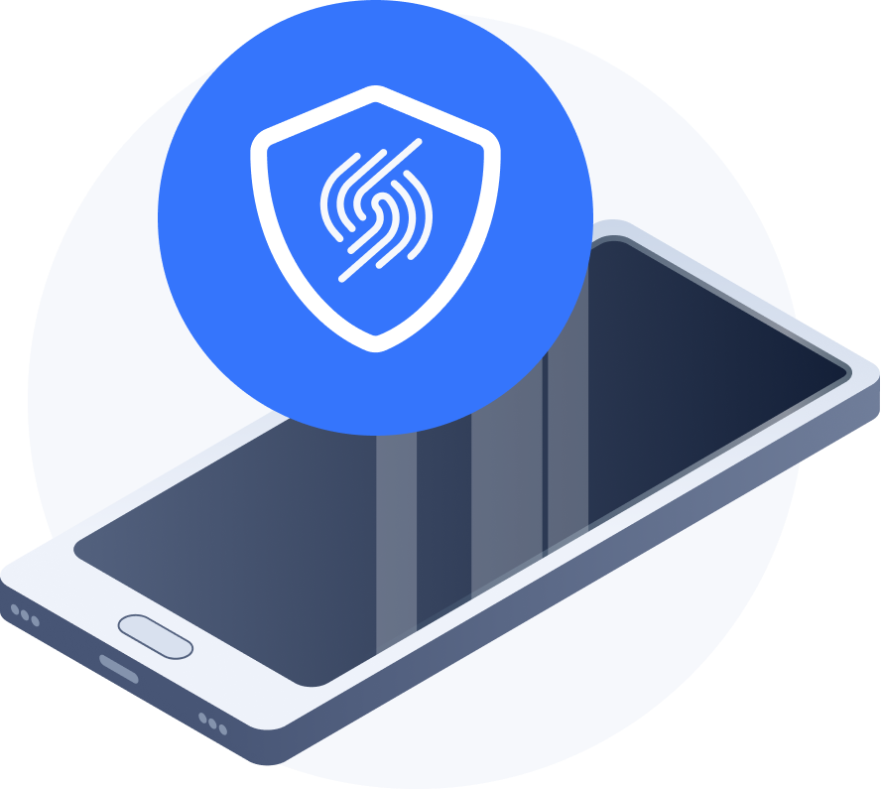
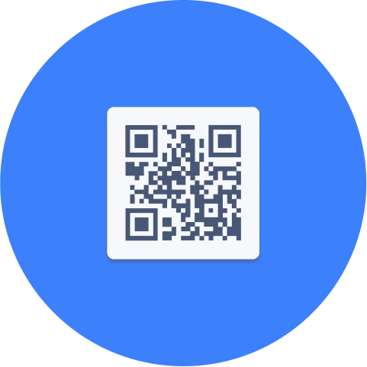




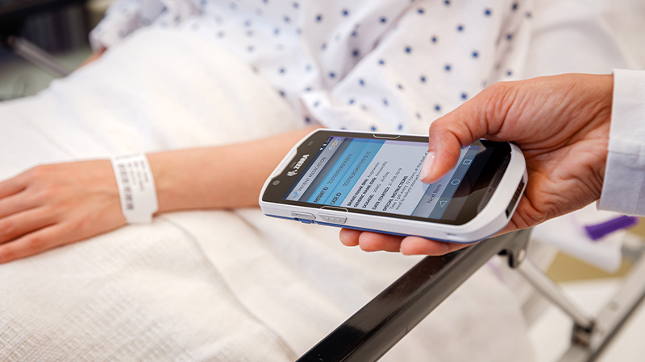





User flows supporting users with and without a smartphone
The issuer completes the test and creates a test credential. A web portal allows the user to collect their test credential remotely when ready.
The user opens their Selv app and scans a QR code to log into the web portal with their digital identity. They download the health credential to their Selv app.
Their health status is now stored locally on their device, with an optional backup. The user owns the data and is the only person who can claim ownership.
A verifier, such as an employer or border agency, scans the user’s QR code. The verifier sees only whether the user qualifies for the activity (e.g. to return to work or to travel).
The user travels to an airport or to work. Society rediscovers some of the freedoms curtailed by COVID-19.
The user is tested or vaccinated at a facility set up by the Government and run by a health authority (a credential issuer).
The issuer completes the test and creates a test credential.
The issuer of the vaccine prints a card or label, featuring a barcode. QR code or card with embedded NFC chip and gives to user. User can request reissue at any time.
The health status is stored ‘within’ the card or label and ‘anchored’ to the IOTA Tangle. The user owns the data and is the only person who can claim ownership.
A verifier, such as an employer or border agency, scans the user’s barcode. The verifier sees only whether the user qualifies for the activity (e.g. to return to work or to travel).
The user travels to an airport or to work. Society rediscovers some of the freedoms curtailed by COVID-19.

Slide 27




Data storage where is the data stored in each verification method ?
Data Storage
‘Anchored’
CONSISENT VERIFICATION METHOD REGARDLESS OF
PHYSICAL / DIGITAL IDENTIFIER
‘Anchored’
‘Anchored’
Data 'anchored' to the IOTA Tangle via an encrypted signature, which could be tied to a national ID # (eg NHS #). Minimises data stored centrally

Slide 28









High level architecture
Issuers
Individuals
Verifiers
Issuers
Individuals
Verifiers
NFC Card based solution
Smartphone based solution
Secure Vaccination Certificates
Ledger APIs

Slide 29



UBIRCH
Live, in-production use of IOTA for certification & validation of Covid-19 test results
IOTA | ETH | GovDigital
uBirch IOTA Github page → https://github.com/ubirch/ubirch-iota-service

Slide 30
We want to collaborate, talk to us.

Slide 31

Partnership Opportunity
We need to collaborate with our partners to deliver a full solution.
Financial benefits
Relationship benefits
Sales and marketing benefits
Technical benefits
If you are an existing Zebra ISV or partner, please contact your AM representative
Sign up here → https://www.zebra.com/gb/en/partners/partnerconnect.html

Slide 32

To request a copy please contact:
integrations@iota.org
michele@iota.org
Partnership Opportunity
We need to collaborate with our partners to deliver a full solution.
IOTA Developer Support:
Jelle Millenaar (jelle.millenaar@iota.org)
IOTA Identity: https://github.com/iotaledger/identity.rs
Selv: https://github.com/iotaledger/selv-mobile
Developer support:
https://docs.iota.org/
IOTA Training:
https://training.iota.org/
Zebra Developer Support:
Zebra CardStudio 2.0 support page: https://www.zebra.com/gb/en/support-downloads/printer-software/design/cardstudio-2-downloads.html
ZebraDesigner software support page:
https://www.zebra.com/gb/en/products/software/barcode-printers/print-dna/zebra-designer.html
Zebra Github page:
ZebraDevs: https://github.com/zebradevs
James S-B: https://github.com/JamesSwinton/Zebra-IOTA-VerifiableCredentials
If you are an existing Zebra ISV or partner, please contact your AM representative
Sign up here → https://www.zebra.com/gb/en/partners/partnerconnect.html

Slide 33
Future developments...

Slide 34



What is the history of my vaccine ?
Enriching the data
Origin
Temperature
Batch number
etc
Notes:
Source:
https://www.canada.ca/en/public-health/services/publications/healthy-living/bar-code-standards-vaccine-products-canada-update-2014-2015.html
https://assets.publishing.service.gov.uk/government/uploads/system/uploads/attachment_data/file/951928/uk-covid-19-vaccines-delivery-plan-final.pdf

Slide 35
Q&A
Alex Fryer
Regional Product Manager IES, EMEA
alex.fryer@zebra.com
Ricardo Moreno
Regional Product Manager Card, EMEA
rmoreno@zebra.com
James Swinton Bland
Developer Advocate,
EMEA
james.swintonbland@zebra.com
Jelle Millenaar
Lead Identity
jelle.millenaar@iota.org
Leo Jugel
CTO
matthias.jugel@ubirch.com

